Slide 1
Liver Disease and Cancers

Slide 2
Learning Objectives
Describe the roles of lipolysis and lipoprotein particles in normal lipid transport
Apply your knowledge of adipose function to describe how cholesterol and triglycerides accumulate in the liver
Describe how obesity-associated atherogenesis progresses, and how this plays a role in cardiovascular disease
Explain the progression of non-alcoholic fatty liver disease (NAFLD)
Describe the relationship between NAFLD and liver cancers
Explain the relationships between elevated liver fat and insulin resistance
Evaluate why certain cancers are tightly associated with obesity

Slide 3
Utilization of Stored Lipids
Used for energy
Promoted by SNS and stress (adrenaline and cortisol)
Blocked by insulin
What do you think would happen in insulin resistance

Slide 4
Excess dietary and released lipids can end up in the liver

Slide 5
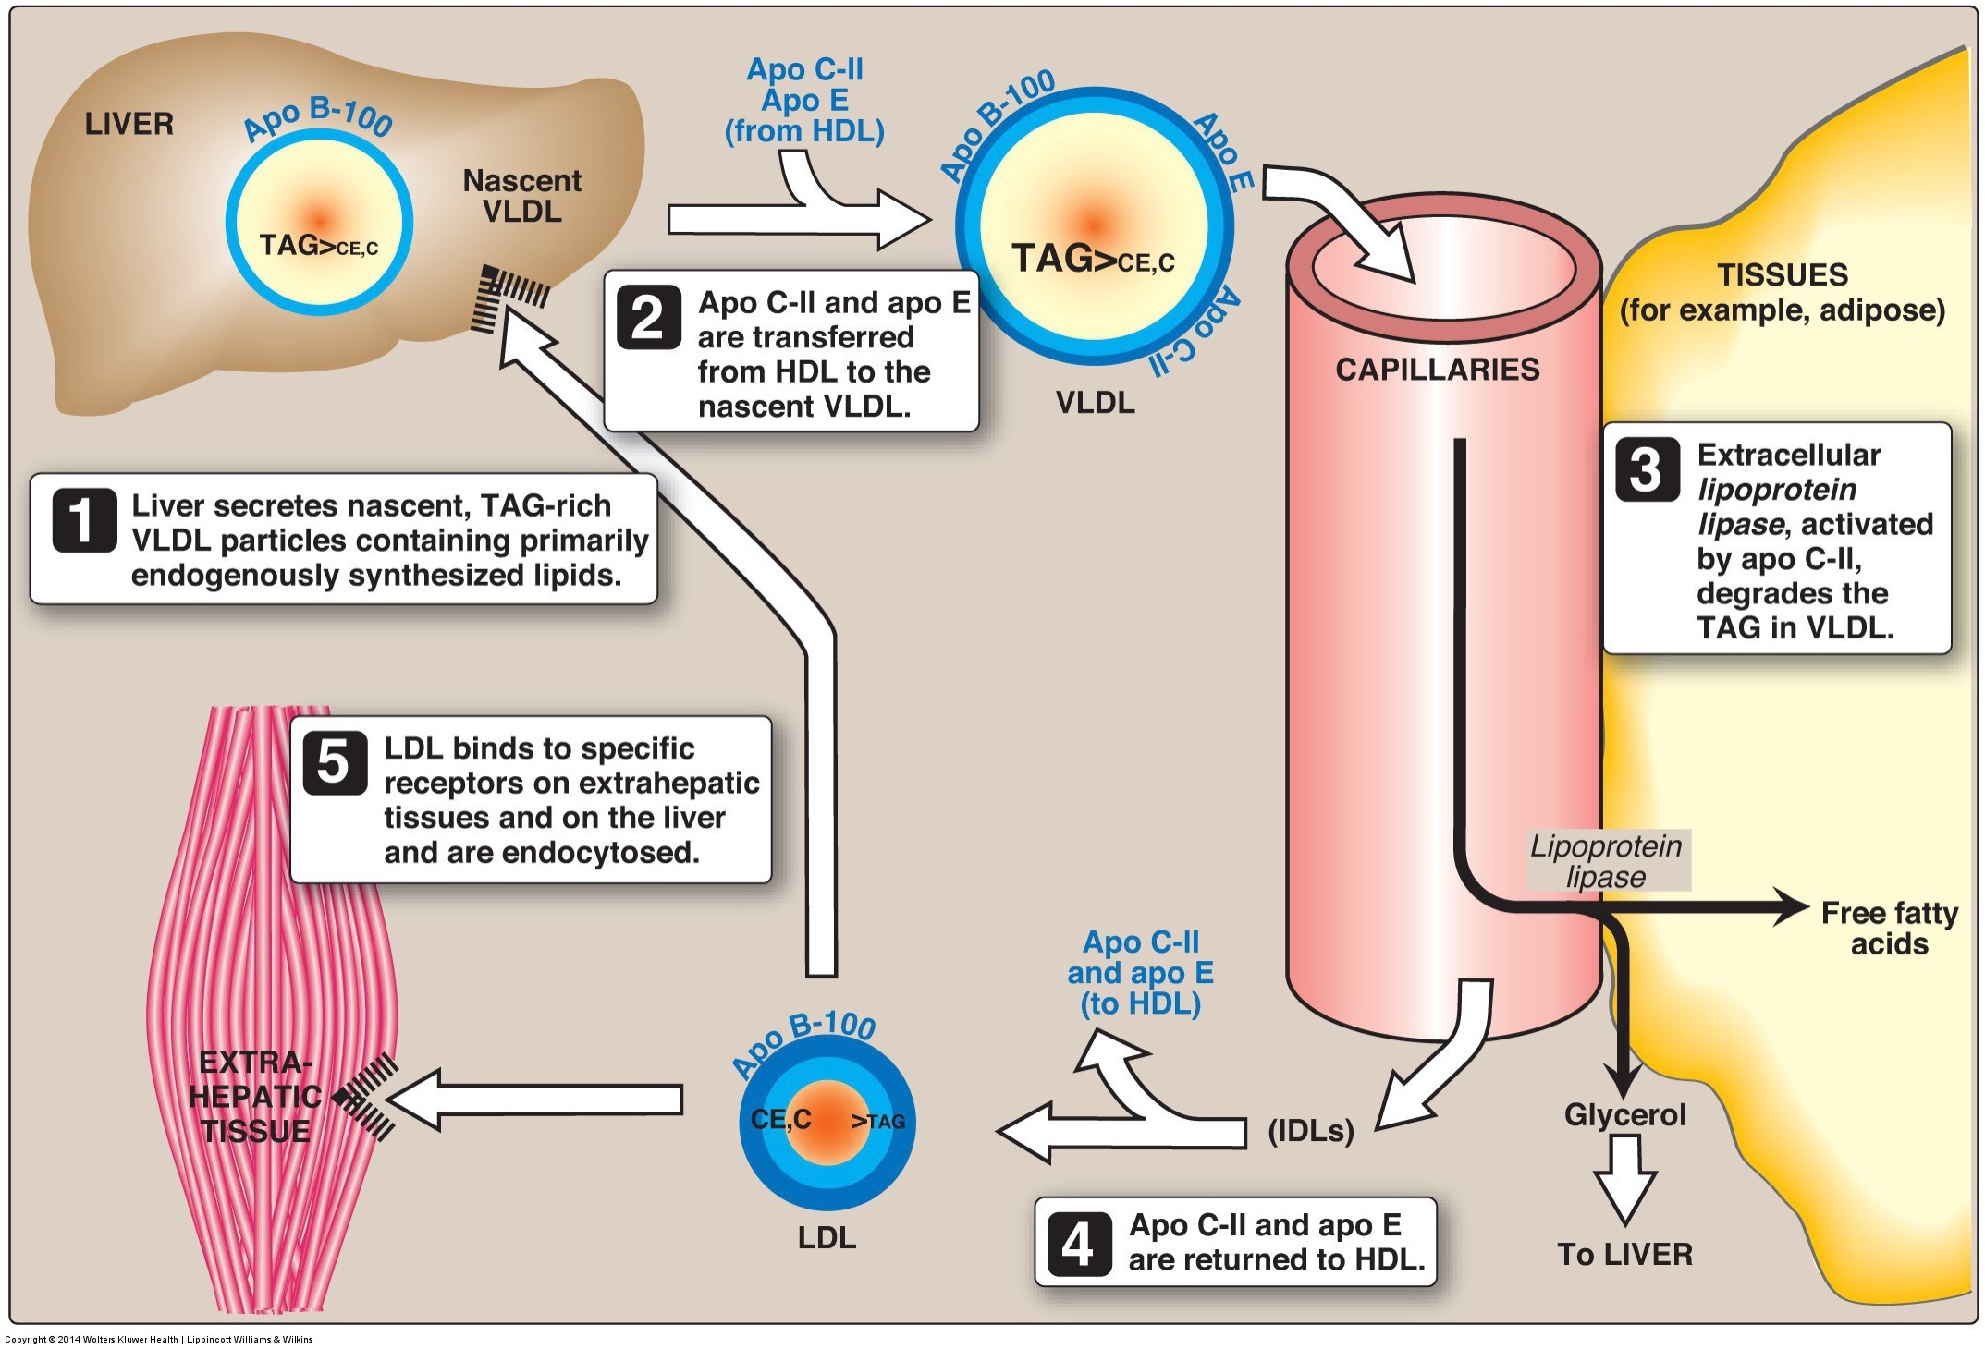
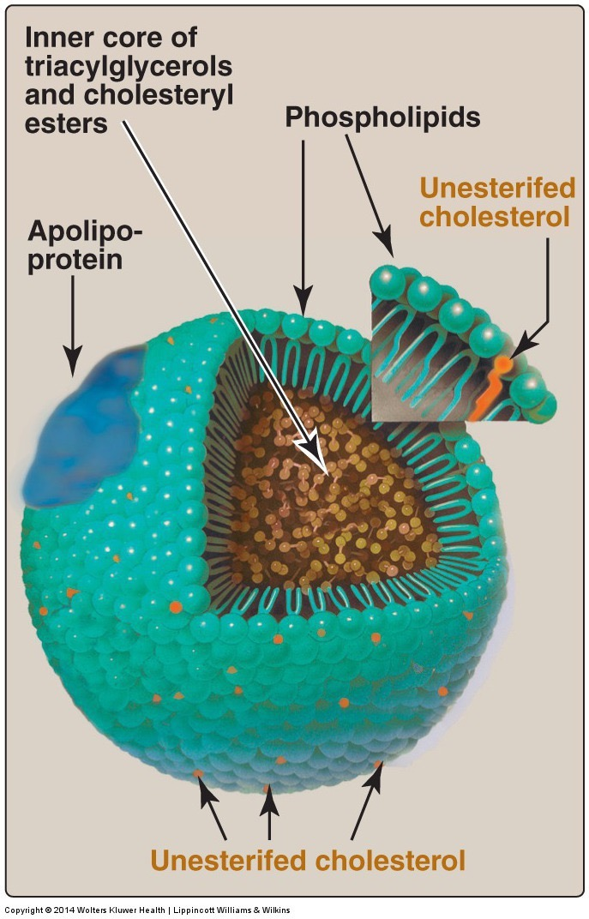
How does the liver release triglycerides?

Slide 6
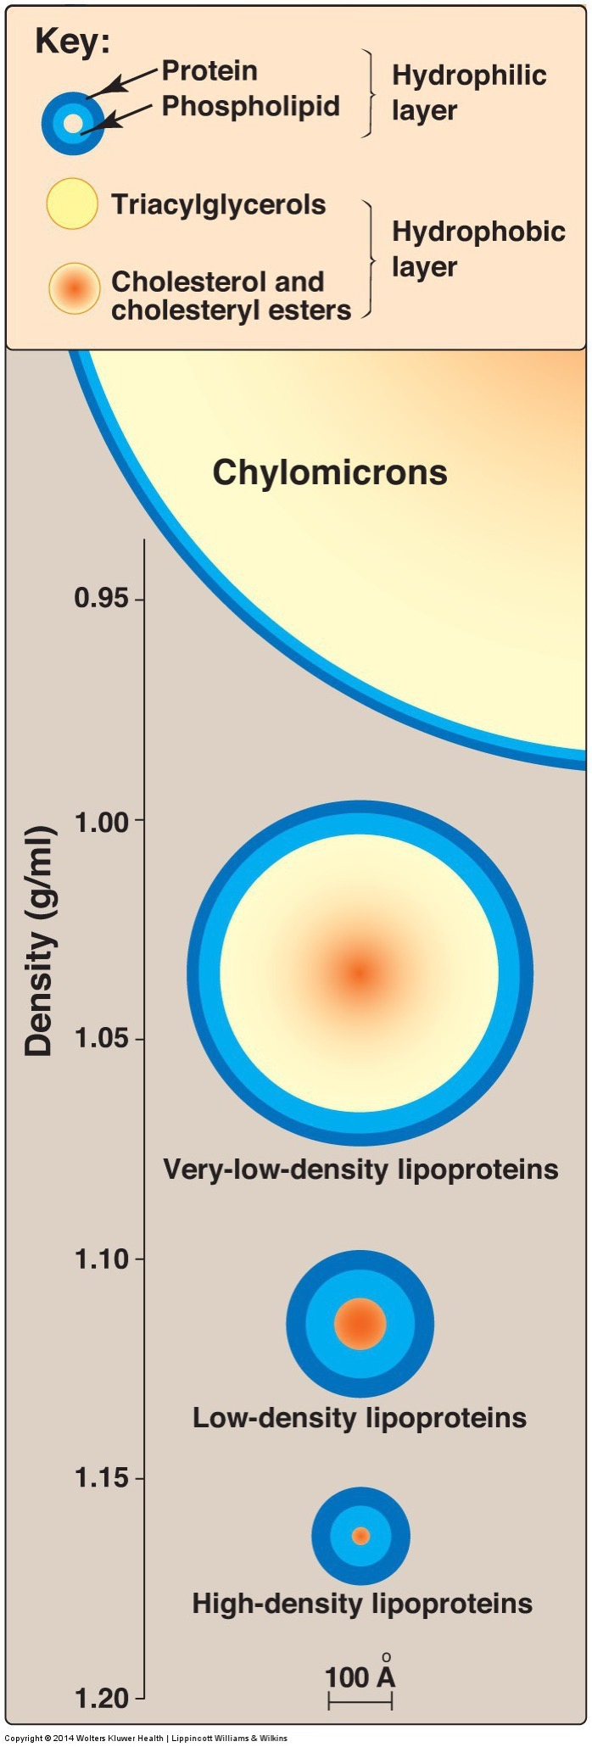
If muscle and adipose arent using the VLDL…
Build up of blood lipoproteins (LDL)
Reduction of empty lipoproteins (HDL)
Excess lipoproteins accumulate in walls of blood vessels

Slide 7
Atherosclerosis and Thrombosis
Increased blood pressure because
Reduces arterial flexibility
Diabetes also causes stiffened arteries
High pressure can lead to release of thrombus
Heart – Heart Attack
Brain - Stroke

Slide 8
Connections between Insulin Resistance and Hyperlipidemia
Obesity -> increased SNS -> higher blood pressure
Obesity -> Insulin resistance
Insulin resistance/diabetes -> more liver fat
Diabetes -> stiffened arteries -> higher blood pressure
Liver fat -> more glucose production and insulin resistance -> Diabetes
Liver Fat -> less particle retrieval -> more LDL
More LDL -> more atherosclerosis -> higher blood pressure

Slide 9
Metabolic Syndrome
Diagnostic criteria (3 of 5)
Waist >40” (M) or 35” (F)
Fasting Glucose >100
Triglycerides >150
HDL < 40 (M) and <50 (F)
Blood Pressure >130 (systolic) or >85 (diastolic)

Slide 10
Progression of NAFLD
Steatosis (more fat)
Steatohepatits (fat and inflammation)
Cirrhosis (scarring)
Hepatocellular carcinoma (liver cancer)

Slide 11
Obesity and Liver Cancer

Slide 12
Other Obesity-Associated Cancers
Incidence/100,000
4.2
3.2
14.8
8.6
1.4
10.9
167 (F)/1 (M)
8.1
11.7
15.6
209
0.5
0.4
Notes:
Corpus uteri -> Cervical

Slide 13
Mechanisms Linking Obesity to Cancer
Excess energy available for cancer growth
Low level chronic inflammation with obesity
Increased insulin/IGF1 (promotes cancer growth)
Increased estrogen production in adipose tissue (Estrogen dependent tumors)

Slide 14
Concept Map

Slide 15
Concept Mapping Exercise
Try to sketch out the relationships between these concepts
Obesity
Narrowed Arteries
Atherosclerosis
Energy Expenditure
Liver Fat
Increased Blood Glucose
Diabetes
Sympathetic Activity
Insulin Production
Thrombosis
Insulin Resistance
Lipolysis
Increased Blood Lipids
High LDL and Low HDL
Vascular flexibility
Cardiac function
Chronic stress
Cirrhosis
Lipolysis
Hepatic Gluconeogenesis
Cancer Growth
Leptin/Melanocortin Signaling

